Slide 1
Class 8: Graph Neural Networks part 2

Slide 2
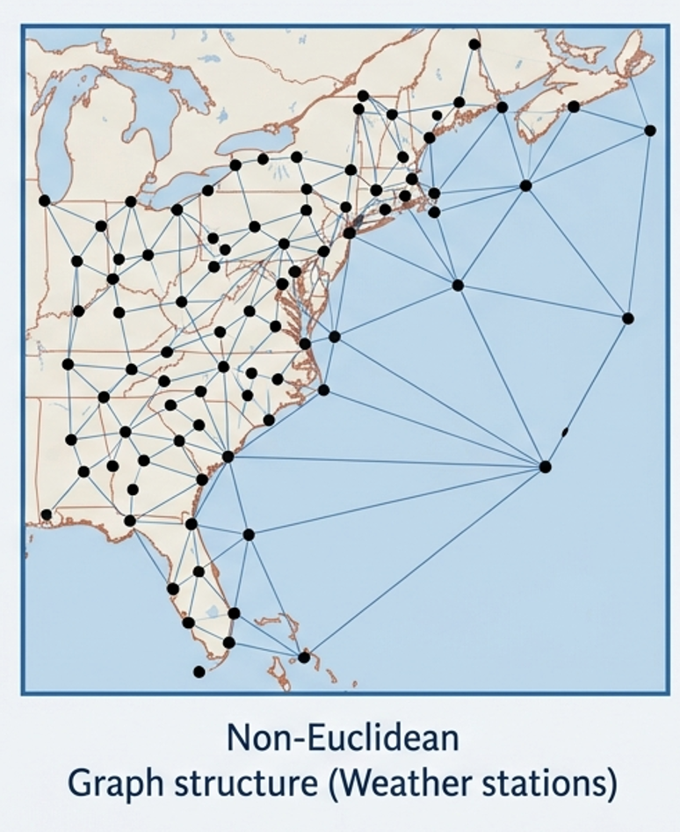
Outline
Move beyond grid-based thinking
Extend the basic GNNs we met last class
Regular grids (i.e. CNNs) struggle with Earth's spherical geometry and irregular station locations
Real physical relationships (river flow, pressure gradients) do not follow pixel neighbors
GCNs allow message passing along the actual paths of physical influence.

Slide 3
Reminder
In standard GNNs we have nodes that are joined by edges
The nodes have ‘features’ that we might like to predict at future time steps or generally make predictions from
We use graph neural networks to work out how much information is shared between the nodes to produce the predictions

Slide 4
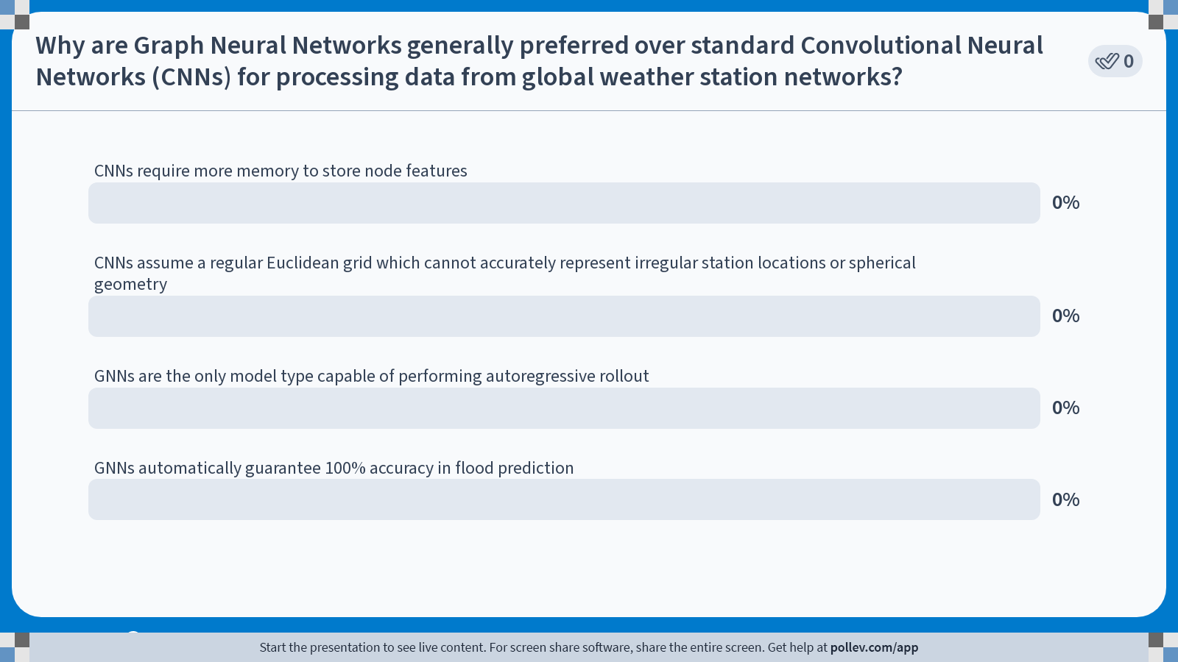
Notes:
Do not modify the notes in this section to avoid tampering with the Poll Everywhere activity. More info at polleverywhere.com/support Why are Graph Neural Networks generally preferred over standard Convolutional Neural Networks (CNNs) for processing data from global weather station networks?
https://www.polleverywhere.com/multiple_choice_polls/epFBBTTnCl9HKEciEAFks?state=opened&flow=Default&onscreen=persist

Slide 5
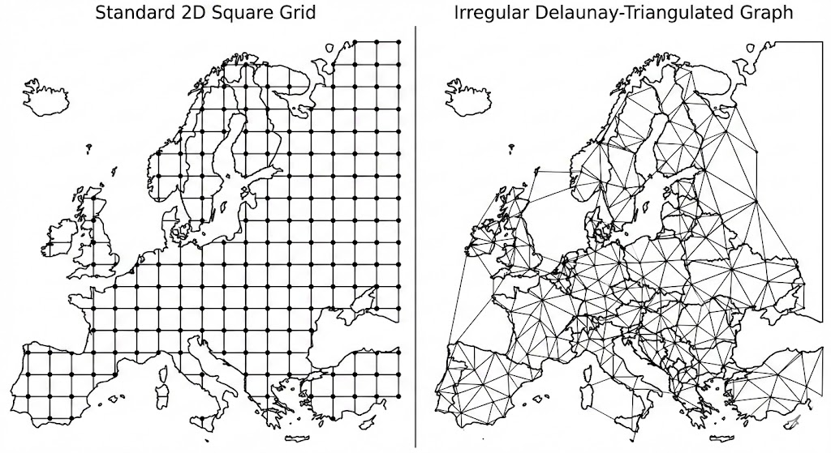
The Weather Graph
Nodes: Represent physical locations (e.g. stations or grid points)
Edges: Represent relationships
Features: Nodes hold state (Temp, Pressure); Edges hold context (Distance, Slope)

Slide 6
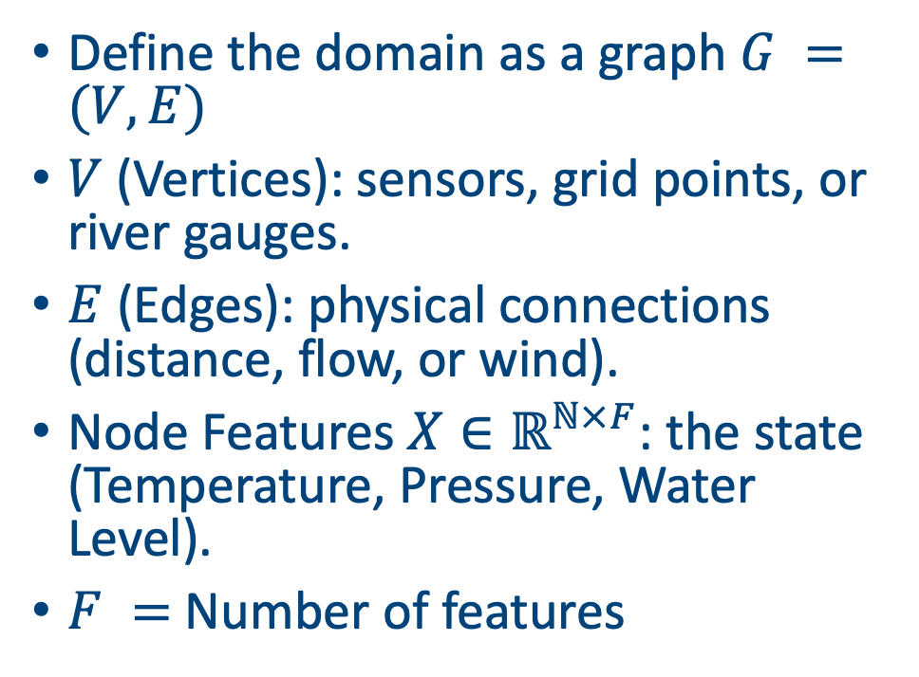
Graphs in maths
Define the domain as a graph $G =(V, E)$
$V$ (Vertices): sensors, grid points, or river gauges.
$E$ (Edges): physical connections (distance, flow, or wind).
Node Features $X∈ℝ^{ℕ×F}$: the state (Temperature, Pressure, Water Level).
$F =$ Number of features

Slide 7
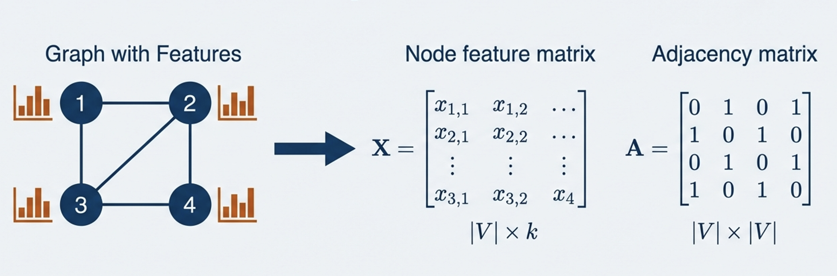
Graphs and convolutions
CNNs: weighted average of pixel neighbours in e.g. a 3x3 grid
GNNs: weighted average of node neighbors in an irregular neighborhood
Shared weights: We use the same learned parameters across the entire graph

Slide 8
Symmetry requirements
We need:
Permutation invariance (if the NN produces a single value it should not matter which order you gives the nodes in)
Permutation equivariance (if the NN produces one value for each node then it should not matter which order you give it the node values)
In weather ML we usually want rotational invariance as well
A simple example explains all

Slide 9
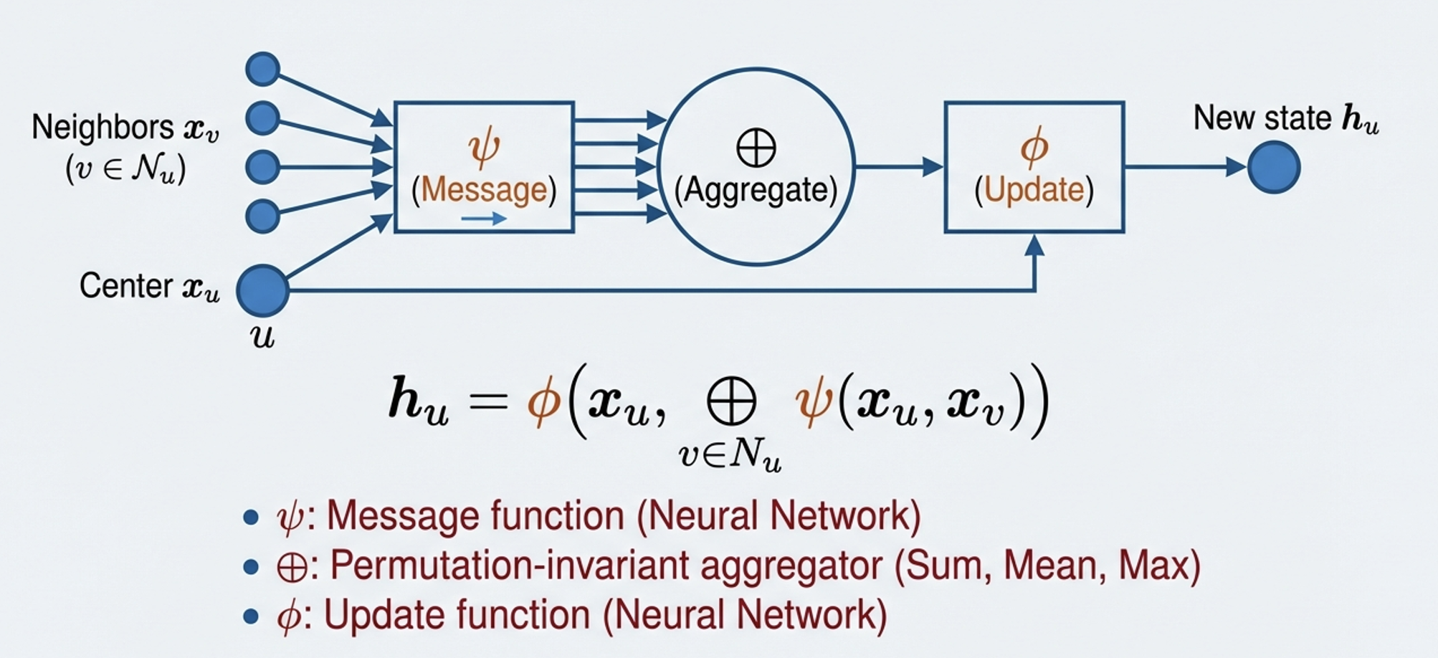
The general GNN recipe

Slide 10
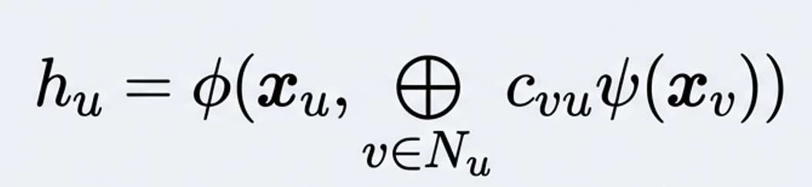
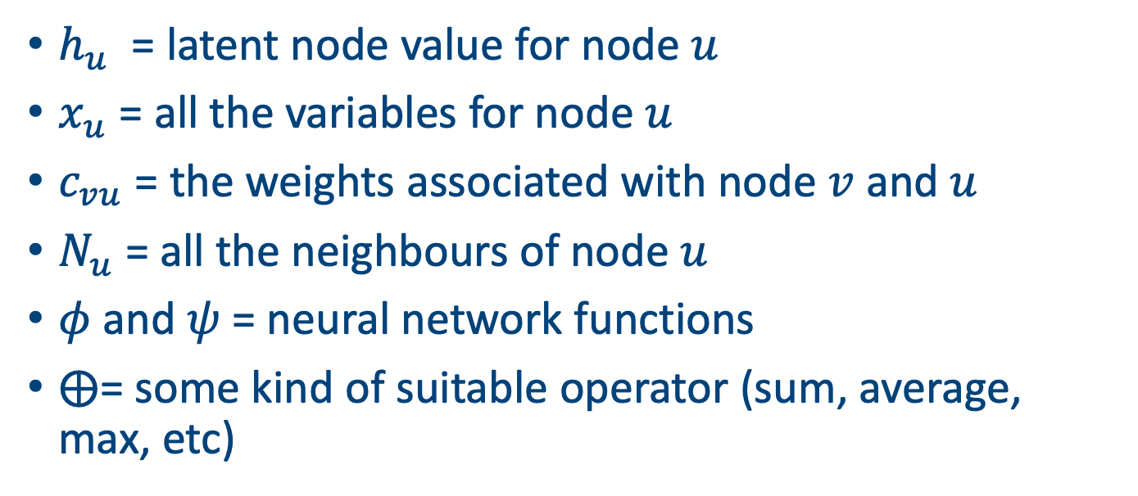
GNN type 1: convolutional layers
$h_{u}$ = latent node value for node $u$
$x_{u}$ = all the variables for node $u$
$c_{vu}$ = the weights associated with node $v$ and $u$
$N_{u}$ = all the neighbours of node $u$
$φ$ and $ψ$ = neural network functions
$⨁$= some kind of suitable operator (sum, average, max, etc)

Slide 11
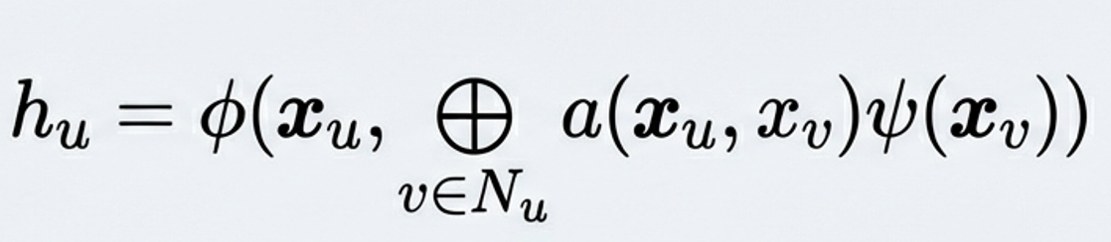
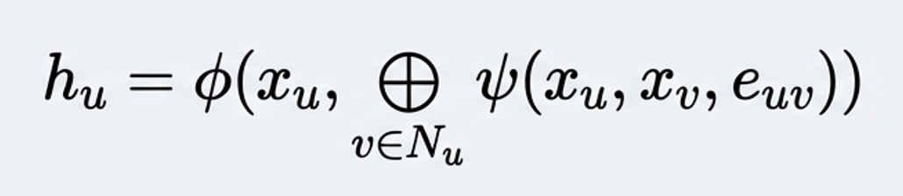
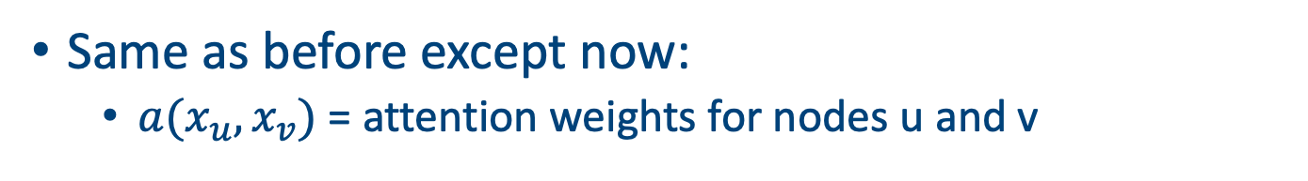
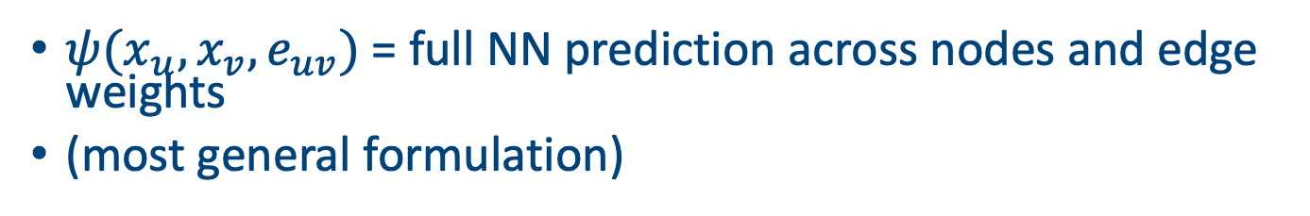
Types 2 and 3: attentional and message passing
Same as before except now:
$a(x_{u}, x_{v})$ = attention weights for nodes u and v
$ψ(x_{u}, x_{v}, e_{uv})$ = full NN prediction across nodes and edge weights
(most general formulation)

Slide 12
GNN layers
Examples

Slide 13
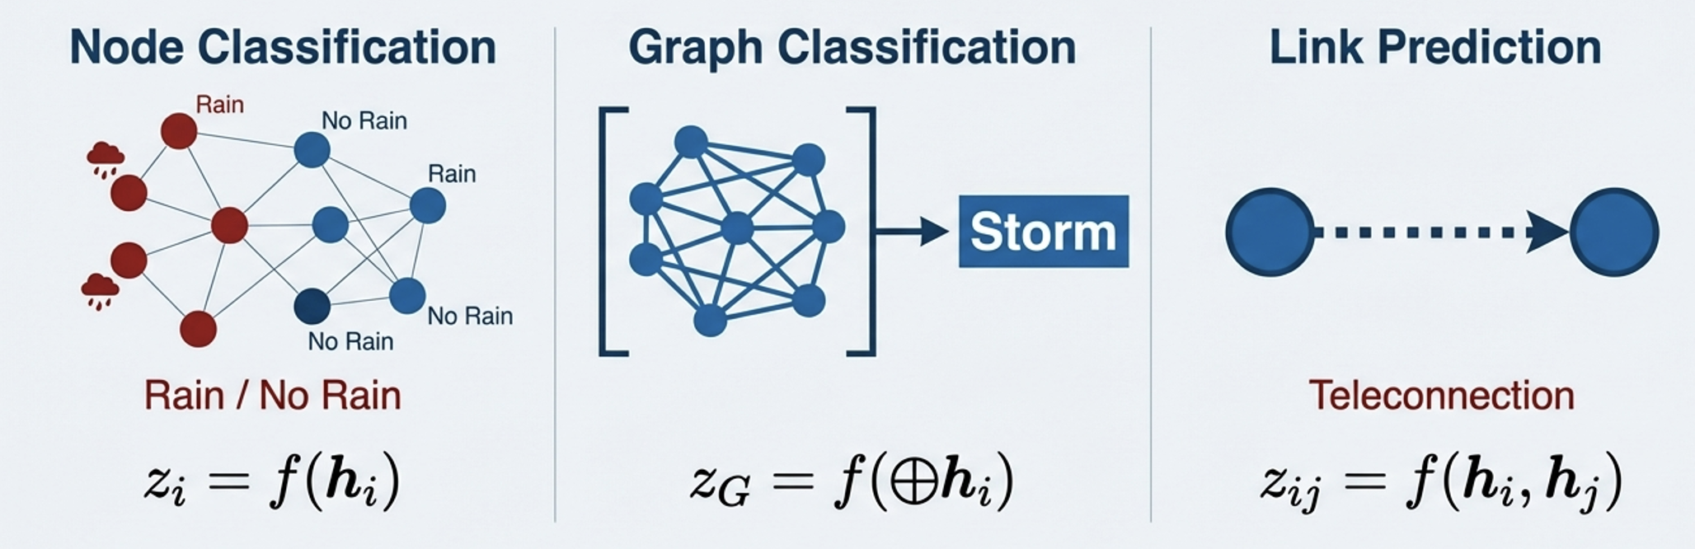
What can you do with these models?

Slide 14
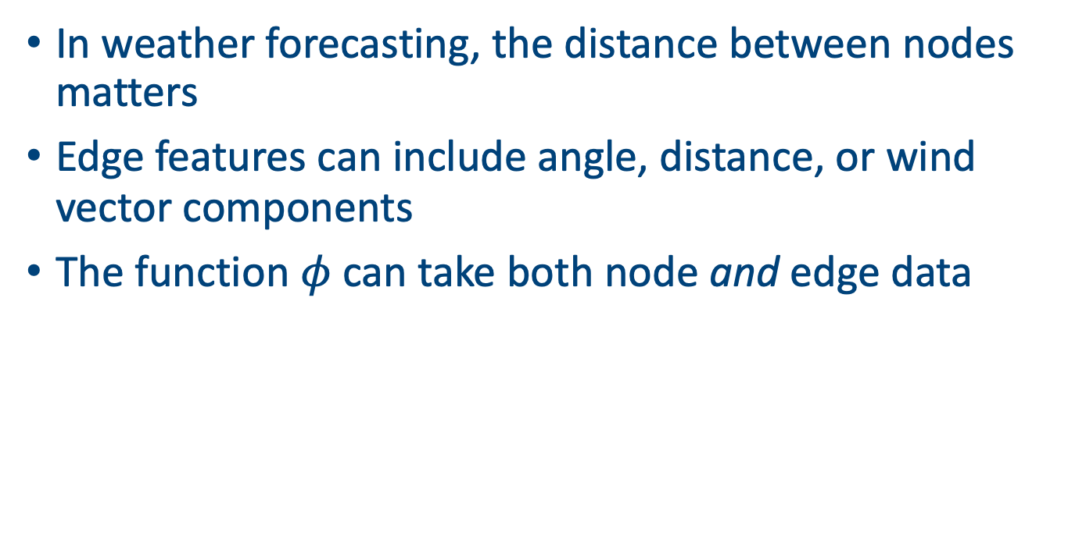
Incorporating Edge Features
In weather forecasting, the distance between nodes matters
Edge features can include angle, distance, or wind vector components
The function $φ$ can take both node and edge data

Slide 15
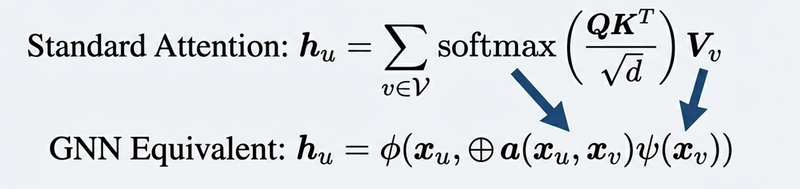

Transformers are GNNs
With a fully connected graph (i.e. $A = {11}^{T}$) we just end up back at a transformer
You can see the similarity between them via:

Slide 16
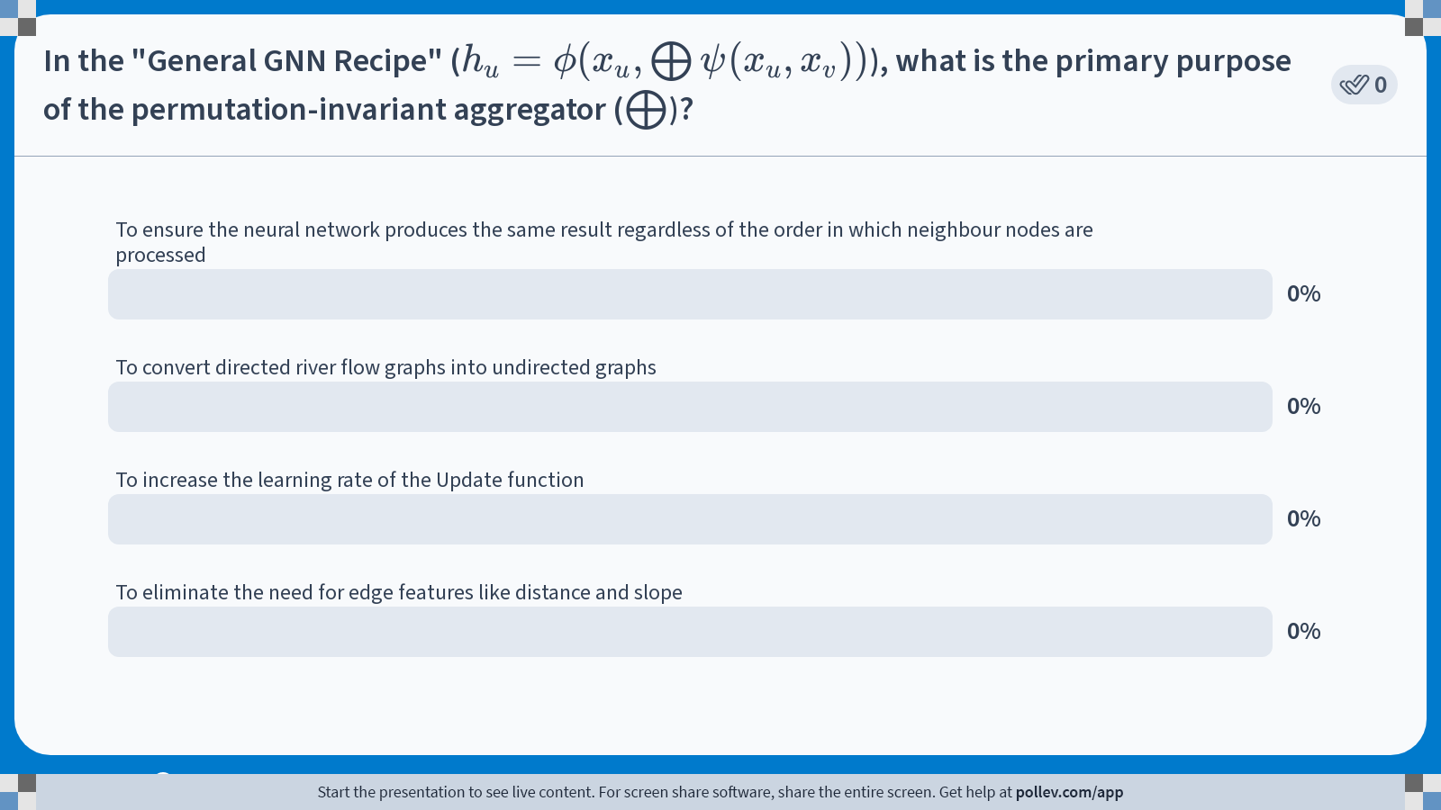
Notes:
Do not modify the notes in this section to avoid tampering with the Poll Everywhere activity. More info at polleverywhere.com/support In the "General GNN Recipe" ($$h_u = \phi(x_u, \bigoplus \psi(x_u, x_v))$$), what is the primary purpose of the permutation-invariant aggregator ($$\bigoplus$$)?
https://www.polleverywhere.com/multiple_choice_polls/udaQbXgbwDkstHkQ4esdk?state=opened&flow=Default&onscreen=persist

Slide 17
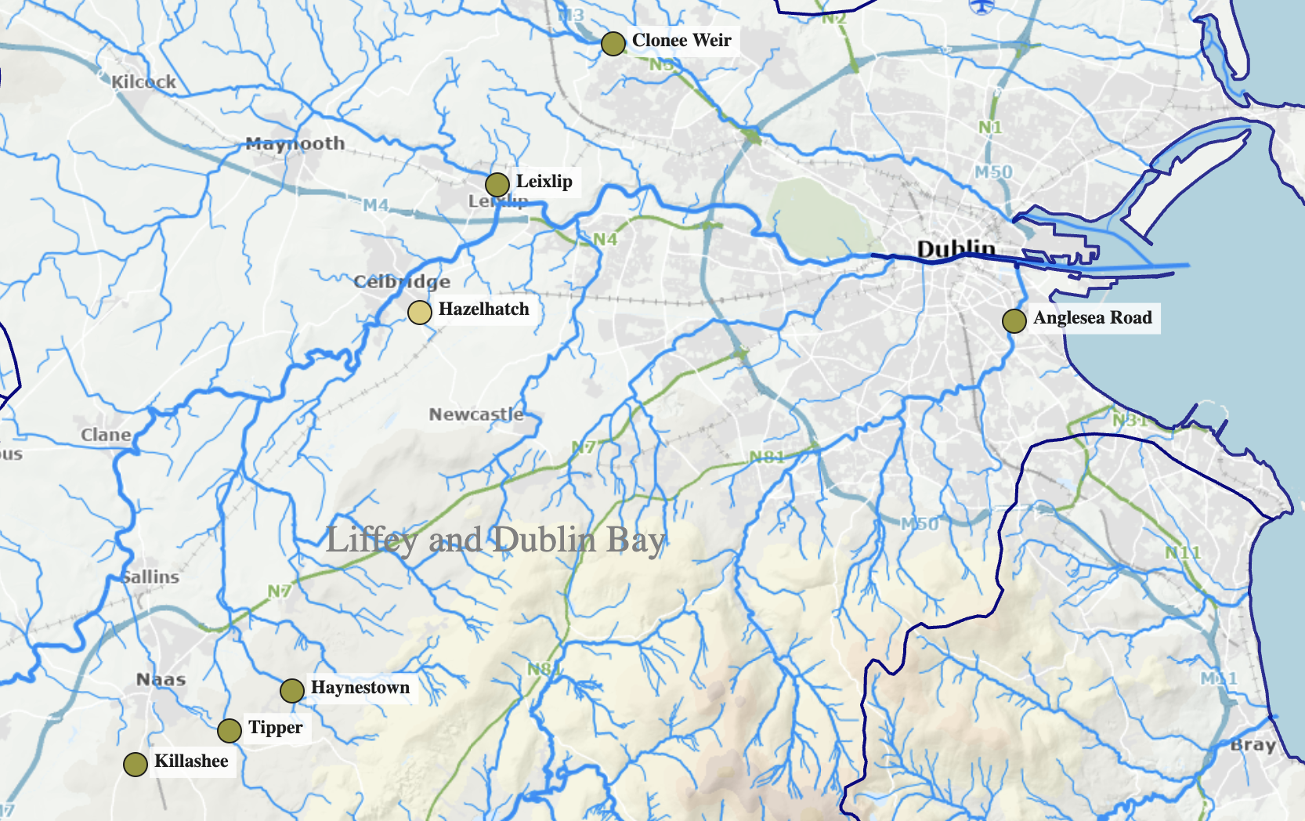
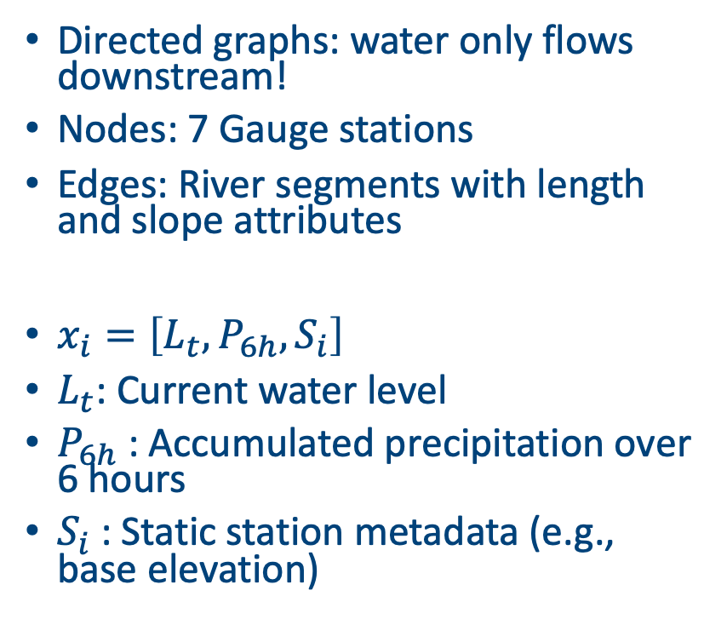
Case Study: River Flow on waterlevel.ie
Directed graphs: water only flows downstream!
Nodes: 7 Gauge stations
Edges: River segments with length and slope attributes
$x_{i}=\left[L_{t}, P_{6h},S_{i}\right]$
$L_{t}$: Current water level
$P_{6h}$: Accumulated precipitation over 6 hours
$S_{i}$: Static station metadata (e.g., base elevation)

Slide 18
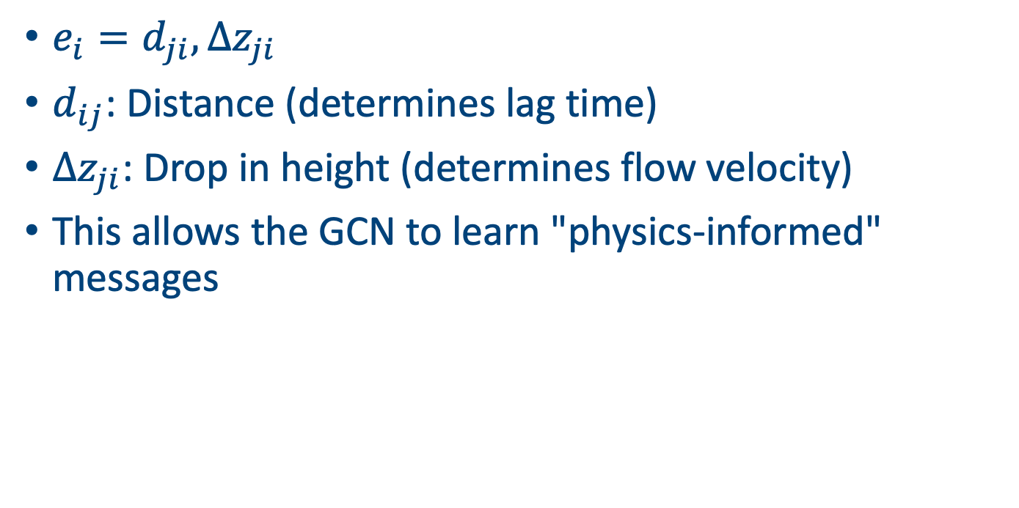
The Edge Feature Vector
$e_{i}=d_{ji}, Δz_{ji}$
$d_{ij}$: Distance (determines lag time)
$Δz_{ji}$: Drop in height (determines flow velocity)
This allows the GCN to learn "physics-informed" messages

Slide 19
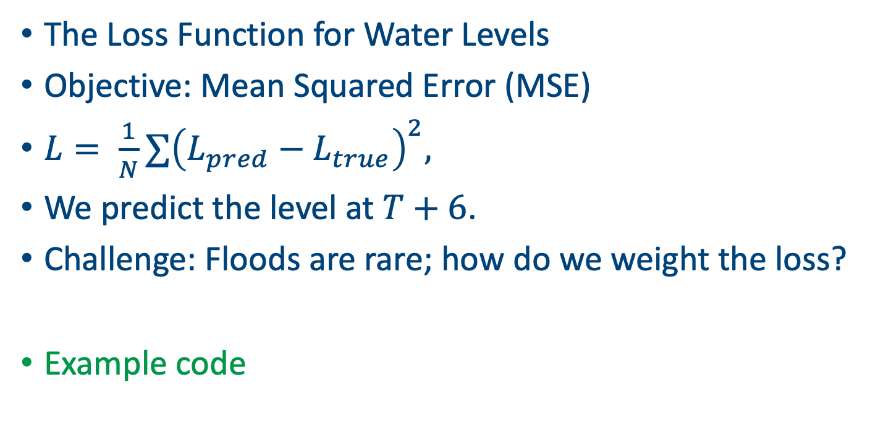
Practical Implementation & Training
The Loss Function for Water Levels
Objective: Mean Squared Error (MSE)
$L= \frac{1}{N}∑{\left(L_{pred}−L_{true}\right)}^{2},$
We predict the level at $T+6$.
Challenge: Floods are rare; how do we weight the loss?
Example code

Slide 20
Transitioning to Global Models
From 5 water gauges to the whole planet
AIFS doesn't use a single grid; it uses a multi-mesh graph
Information needs to travel from the Pacific to Europe
How do we ensure fast propagation?

Slide 21
The Encoder-Processor-Decoder
The High-Level AIFS Architecture
Encoder: Moves data from the Lat/Lon grid to the Graph
Processor: 15-20 GCN layers performing global message passing
Decoder: Moves data back to the grid for forecasting

Slide 22
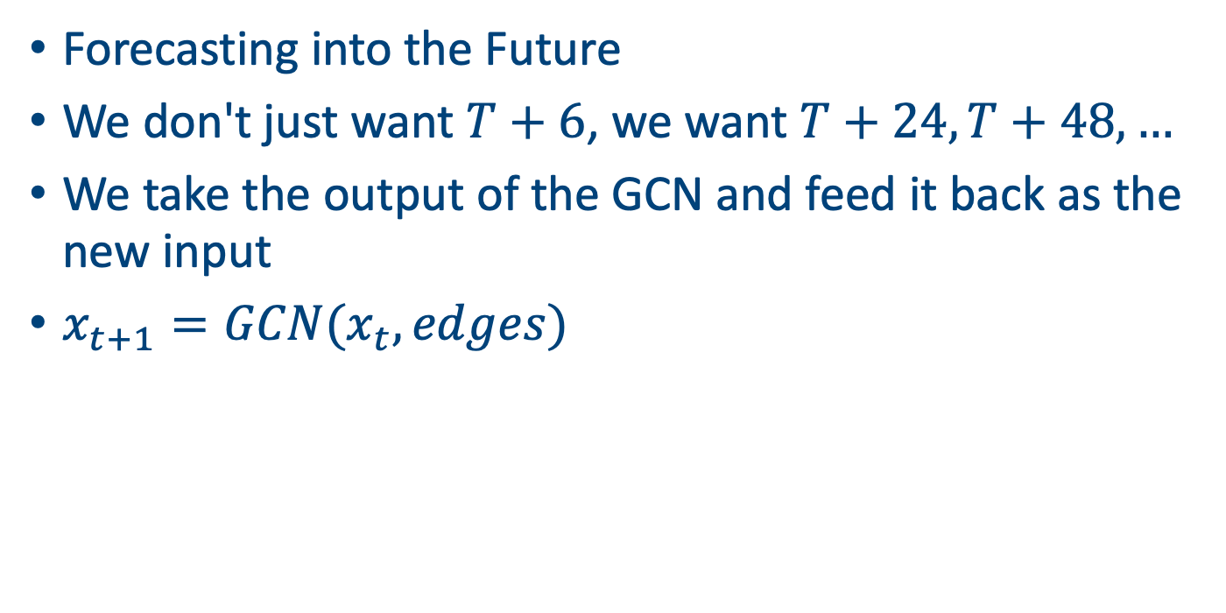
Autoregressive Rollout
Forecasting into the Future
We don't just want $T+6$, we want $T+24, T+48,…$
We take the output of the GCN and feed it back as the new input
$x_{t+1}=GCN(x_{t}, edges)$

Slide 23
Looking ahead
Starting to look at AIFS and Anemoi
We will explore the Anemoi library
How to handle 40,000+ nodes instead of 5!

Slide 24
Summary
GNNs generalise neural networks to (irregular) graph structures
Weather forecasting benefits from capturing spatial relationships
We have covered 3 different types of GNN
Can combine with transformers, convolutions and message passing to model complex interactions between neighbours
Frameworks like PyTorch Geometric make implementation practical

Slide 25
Relevant code
Irish_ERA5_GNNs.ipynb
water_level_example.ipynb

Slide 26
Afternoon session instructions
Go and download some more water stations from waterlevel.ie
Fit some more models and see how far you can push the accuracy/richness of the model
Present your results in 5 minutes

